Slide 1
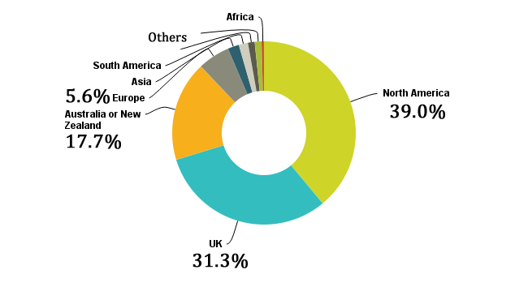
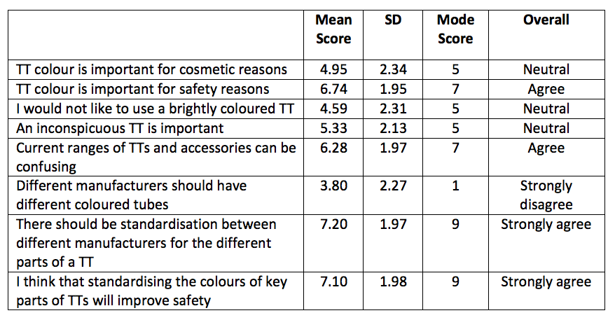
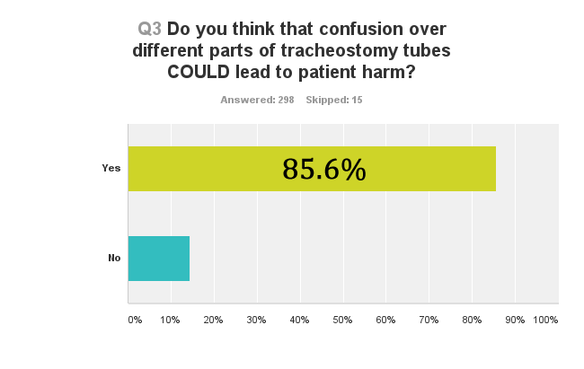
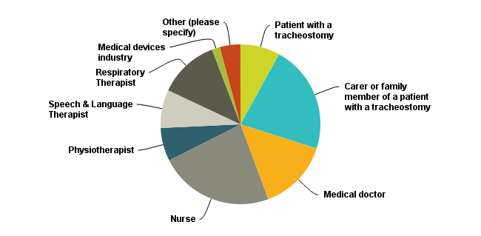
Colours for key parts of tracheostomy tubes can impact on patient safety perceptions and experiences – an international survey.
BA McGrath⁺, S Wallace$, J Lynch*, E Ward%
⁺ICU Consultant, $Speech & Language Therapist, *Tracheostomy QI Project Lead (ICU Charge Nurse), %Parent and Patient & Families Lead, Global Tracheostomy Collaborative
^{+$*}University Hospital South Manchester, Wythenshawe, M23 9LT. Boston, Massachusetts, US
Avoidable harm occurs in patients requiring tracheostomies. Most studies are performed in the hospital setting and have identified recurrent themes including deficiencies in staff education, training and competency, and in the provision and safe use of tracheostomy-related equipment. Anecdotal reports where confusion over key parts caused harm led us to design a survey in an attempt to define this problem in detail. We hypothesised that identifying key parts of tracheostomy tubes with different colours could lead to improvements in safety, but that coloured tubes may be unacceptable to patients and staff.
The Global Tracheostomy Collaborative (GTC, www.globaltrach.org) is a non-profit organization committed to improving tracheostomy care for patients and families worldwide. Using the power of the collaborative our aim was to rapidly collect data regarding patient safety incidents from patients and staff around the world, and explore perceptions about the role of coloured key parts for tracheostomy tubes.
There were 313 responses recorded between 5th June and 27th July 2015. Eighty five percent of respondents felt that confusion over colour could lead to patient harm, with 38.8% reporting in detail actual ‘serious’ harm (emergency services or resuscitation team called).
Table 1. Likert response scale was bounded by 1 (strongly disagree) through 5 (neutral) to 9 (strongly agree). TT tracheostomy tube, SD standard deviation.
An internet-based survey was made available via SurveyMonkey (www.surveymonkey.com) and participants were invited by email and social media via the GTC networks. Responses were collected using check-box questions and free text. A number of statements were provided with agreement recorded on a Likert scale, bounded by 1 (strongly disagree) through 5 (neutral) to 9 (strongly agree). For simplicity, mean and mode Likert scores are reported in Table 1.
Safety concerns outweighed cosmetic considerations and that standardization of the colours of key parts between manufacturers will likely improve safety. The GTC is committed to working with patients and industry to improve tracheostomy safety and industry-wide recognition and agreement on standardizing key parts of these devices could have important safety benefits for patients and staff.
References
1. AN Thomas, BA McGrath. Patient safety incidents associated with airway devices in critical care: a review of reports to the UK National Patient Safety Agency. Anaesthesia 2009;64:358–65.
2. BA McGrath, AN Thomas. Patient safety incidents associated with tracheostomies occurring in hospital wards: a review of reports to the UK National Patient Safety Agency. Postgrad Med J. 2010;86:522–5.
3.KA Wilkinson, IC Martin, H Freeth, et al. NCEPOD: On the right Trach? 2014 Available from: www.ncepod.org.uk/2014tc.htm Accessed July 2015
4. P Das, H Zhu, RK Shah, DW Roberson, et al. Tracheotomy-related catastrophic events: results of a national survey. Laryngoscope 2012;122:30–7.

