Slide 1
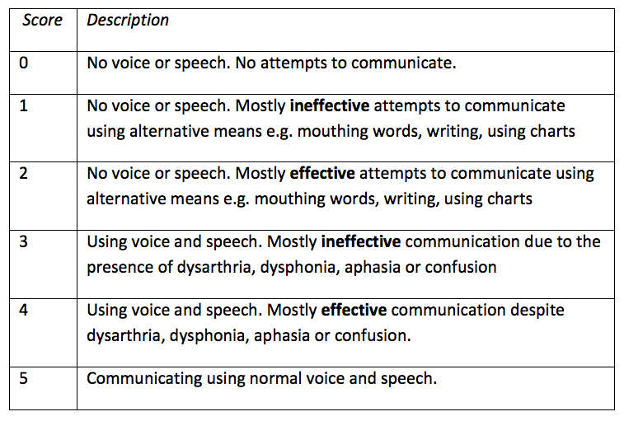
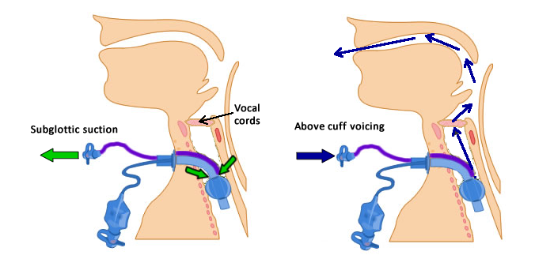
Evaluating the Effectiveness of Communication in Ventilator-Dependant Tracheostomy patients utilising Above Cuff Vocalisation:
The ICU Functional Communication Scale
S Wallace$, J Lynch*, L Nicholson$, M Wilson$, R Purcell$, BA McGrath⁺
$Speech & Language Therapist, *Tracheostomy QI Project Lead (ICU Charge Nurse), ⁺ICU Consultant
Acute Intensive Care Unit, University Hospital South Manchester, Southmoor Road, Wythenshawe, Manchester. M23 9LT
National guidelines recommend early recognition of communication problems and involvement of Speech & Language Therapy (SLT) in ICU. Ventilator-dependant tracheostomy patients requiring cuff inflation have airflow excluded from the upper airway, limiting the ability to communicate by vocalisation/speech.
Above Cuff Vocalisation (ACV) is a method of communication allowing additional gas flow to be delivered via the subglottic suction port of the tracheostomy tube exiting via the larynx, in patients unable to tolerate cuff deflation. This technique does not require a tube change to a specialist ‘talking tube’ and is well tolerated. Resultant speech quality is variable and success needs monitoring, however existing ICU functional assessment scales are lengthy, may require training, focus on physical function or disability and are unsuitable for speech .
It should be emphasised that ACV should not be undertaken by non-specialist staff without experience of the technique.
Our aims were to develop and trial a new simple scale to evaluate the effectiveness of functional communication in patients utilising ACV and to determine whether the scale could be used consistently by both SLT and non-specialist ICU staff.
Our service introduced ACV using standard Smiths-Medical (Ashford, UK) Blue Line Ultra Suctionaid (BLUS) tracheostomy tubes to facilitate communication. Scale parameters (below) were devised by consensus amongst SLT, nursing, medical and physiotherapy staff. The scale was trialled in five consecutive patients undergoing ACV.
The ICU Functional Communication Scale was effective in detecting small improvements in communication ability and can be used effectively by multidisciplinary staff as part of a range of tools to evaluate the impact of ACV. This simple scale has the potential to be applied across all ICU patients.
Simply defining communication problems may facilitate early SLT referral and communication goals and monitor communication outcomes. Larger studies are required for validation of our scale and further detailed study of the scale and of ACV and its clinical efficacy is on-going.
References
1. KA Wilkinson, IC Martin, H Freeth, et al. NCEPOD: On the right Trach? 2014. www.ncepod.org.uk/2014tc.htm.
2. R Khalaila, W Zbidat, K Anwar, et al. Communication difficulties and psychoemotional distress in patients receiving mechanical ventilation. Am J Crit Care. 2011;20:470-479.
3. M Kunduk, K Appel, M Tunc, et al. Preliminary report of laryngeal phonation during mechanical ventilation via a new cuffed tracheostomy tube. Respir Care. 2010;55:1661-1670.
4. V Pandian, CP Smith, TK Cole, et al. Optimizing Communication in Mechanically Ventilated Patients. J Med Speech Lang Pathol. 2014;21:309-318.
5. A Christakou, E Papadopoulos, I Patsaki, et al. Functional Assessment Scales in a General Intensive Care Unit. Hospital Chronicles. 2013;8:164–170
6. GPICS Guidelines for the Provision of Intensive Care Services. https://www.ficm.ac.uk/sites/default/files/GPICS%20-%20Ed.1%20%282015%29.pdf
7. NICE guidelines CG83. Rehabilitation after critical illness in adults. March 2009. https://www.nice.org.uk/guidance/cg83
The authors gratefully acknowledge the Global Tracheostomy Collaborative (www.globaltrach.org) in sharing experience and protocols regarding the use of ACV, especially Mrs Tanis Cameron, TRAMS team, Austin Health, Melbourne, Australia. www.tracheostomyteam.org). This work was carried out as part of a project funded by the Health Foundation’s Shine programme. The Health Foundation is an independent charity working to improve the quality of healthcare in the UK. The authors have received unrestricted funding from Smiths Medical to evaluate BLUS tubes for the purposes of ACV in a future study.

